Slide 1


AWS Console
Collection of services

Slide 2
Introduction
AWS stands for Amazon Web Services, which is a cloud computing platform. It is designed in such a way that it provides cloud services in the form of small building blocks, and these blocks help create and deploy various types of applications in the cloud. These sequences of small blocks are integrated to deliver the services in a highly scalable manner.

Slide 3
Purpose
The AWS service is provided by the Amazon that uses distributed IT infrastructure to provide different IT resources available on demand.
It provides different services such as infrastructure as a service (IaaS), platform as a service (PaaS) and packaged software as a service (SaaS)

Slide 4
ADVAntages of AWS
A small manufacturing organization uses their expertise to expand their business by leaving their IT management to the AWS.
A large enterprise spread across the globe can utilize the AWS to deliver the training to the distributed workforce.
An architecture consulting company can use AWS to get the high-compute rendering of construction prototype.
A media company can use the AWS to provide different types of content such as ebox or audio files to the worldwide files.

Slide 5
AWS services
Amazon Web Services (AWS) is the world's most comprehensive and broadly adopted cloud platform, offering over 200+ fully featured services from data centers globally.
We have different domains in which AWS offer services.
In search bar, we can search for required service as shown below:

Slide 6

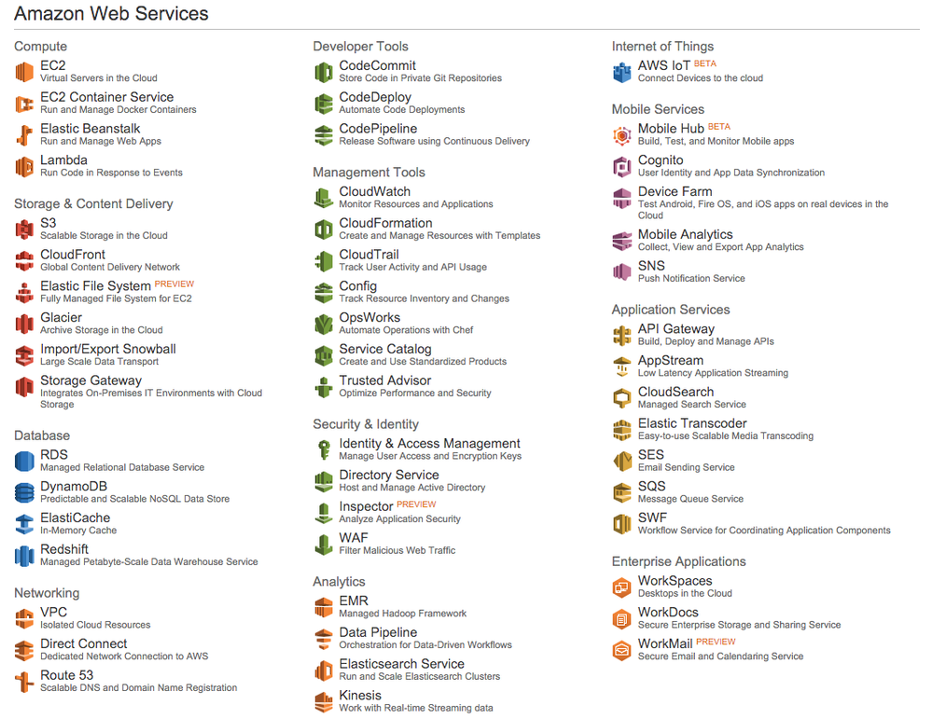

Slide 7
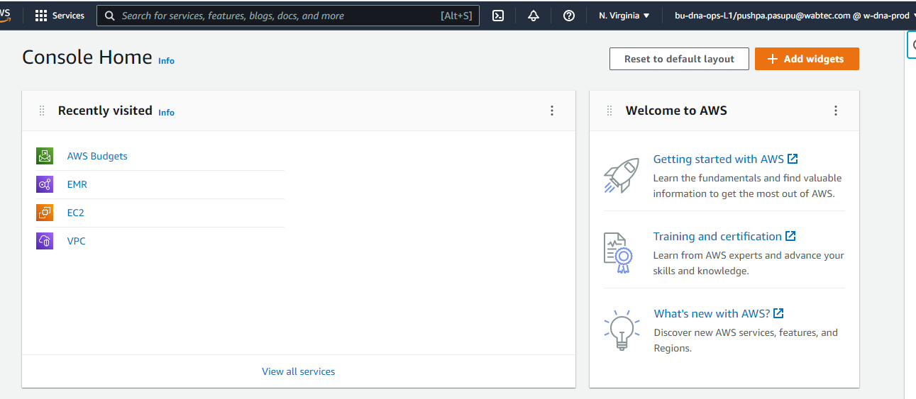

Slide 8

THANKS

